Slide 1
Animal diseases and modes of transmission

Slide 2
Name a disease that each of these animals can contract:
Cat
Dog
Rabbit
Goats
Chickens
Bearded Dragon
Write your answers in your notebook

Slide 3
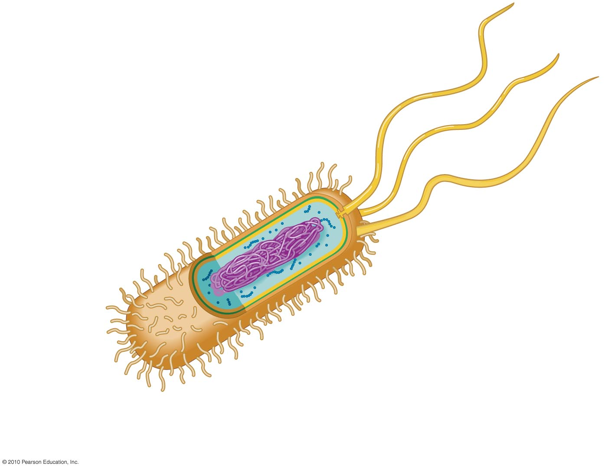
Disease causing Microorganisms;
BACTERIA
Living cell that can reproduce by itself.
Does not need a host to survive (It doesn't have to live inside an animal - It can live in the environment)
Invisible to the naked eye.
Has a cell wall

Slide 4
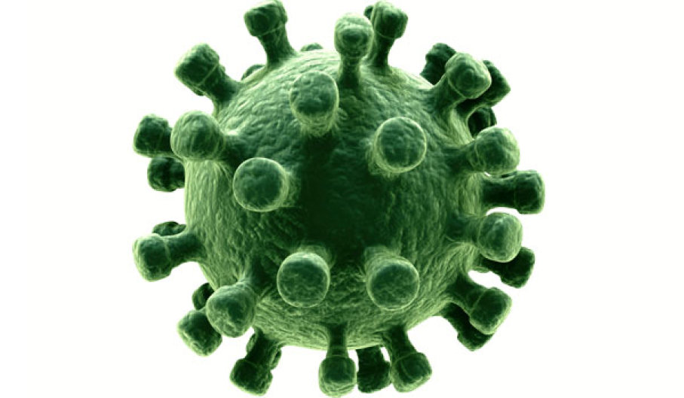
Disease causing Microorganisms;
VIRUS
Has a protein coating (instead of a cell wall)
Not living itself - uses living animals cells to survive (so MUST have a host)
Even smaller than a Bacteria! Must use a strong microscope to see.

Slide 5
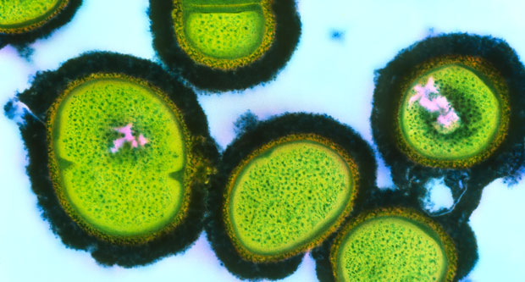
Disease causing Microorganisms;
FUNGI
Includes moulds, yeasts and mushrooms.
Most fungi can be seen with the naked eye.
Most fungi live in the environment and do not need a host to survive.

Slide 6
 | Can it live/reproduce in the environment? | Does it need a host to survive? | Can it be seen with the naked eye?
Bacteria
Virus
Fungi

Slide 7
 | Can it live/reproduce in the environment? | Does it need a host to survive? | Can it be seen with the naked eye?
Bacteria | Yes | No | No
Virus | No | Yes | No
Fungi | Yes | No | Yes

Slide 8
Name three differences between a Bacteria and a Virus
__________________________________________________________________________________________________________________________
__________________________________________________________________________________________________________________________
__________________________________________________________________________________________________________________________

Slide 9
Name three differences between a Bacteria and a Virus
A bacteria has a cell wall, a virus has a protein coating.
A bacteria is a living cell (that does not need a host). A virus is not living (therefore needs a host to survive).
A bacteria is much bigger than a virus.

Slide 10
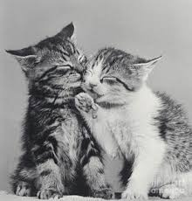
Modes of transmission:
Direct contact : defined as occurring when one part of an animal comes into contact with the body of another animal
Eg. Skin to skin contact - Mother nursing puppies/kittens
- Animals playing together
Animals licking/grooming each other

Slide 11
Modes of transmission:
Indirect contact: defined as occurring when two or more animals come into contact with the same materials (or objects) which then act as the source of infection.
Eg . Bodily secretions (blood/ saliva/ vomit/ feces/ mucus/ reproductive fluids)
Objects (bedding/ housing/ water bottles/ brushes/ food)

Slide 12
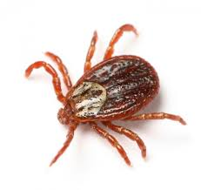
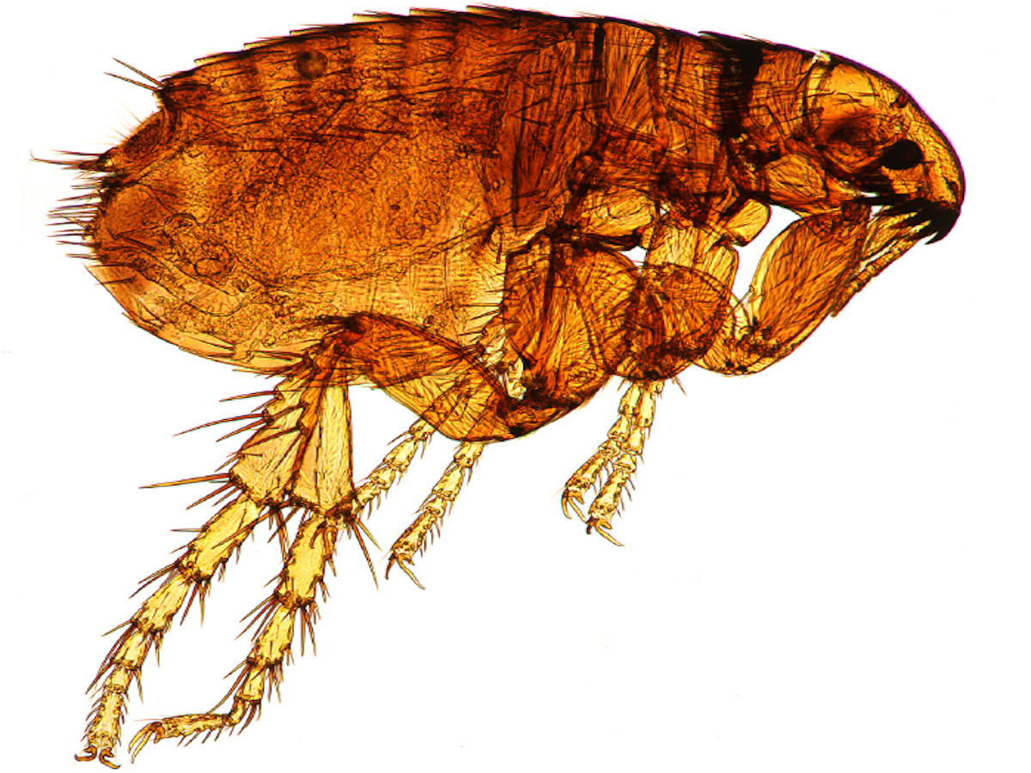
Modes of transmission:
Vector transmission: when disease is spread by biting insects and ticks. The insect or tick carries the disease but is not affected by the disease.

Slide 13
What could you do to prevent diseases being spread by each mode of transmission?
Direct Contact | Indirect contact | Vector Transmission

Slide 14
What could you do to prevent diseases being spread by each mode of transmission?
Direct Contact | Indirect contact | Vector Transmission
Isolate any animals that come onto the premises until you are sure they are healthy. Quarantine any ill animals until they are recovered. Keep animals away from wildlife where possible. | Use P.P.E (Personal Protective Equipment) when treating illness and ensure it is changed between animals. Clean and disinfect animal housing and accessories regularly. Dispose of animal waste properly. | Treat animals for parasites. Treat environment for parasites. Vaccinate animals

Slide 15
Write up a list of what you can do daily and weekly to help prevent and control disease (pick an animal we look after in school!)
Daily | Weekly

